Slide 1
“Netflix Original Films and IMDB Scores Dataset”
Meera Khadka
Hridaya Manandhar
Nirjala Pandey

Slide 2
Project Overview
In this project, we explore and analyze the Netflix Originals dataset, which contains information about movies and series released as Netflix Originals.
The goal is to understand the data structure, assess its quality, and uncover insights that can inform content strategies or modeling tasks.

Slide 3
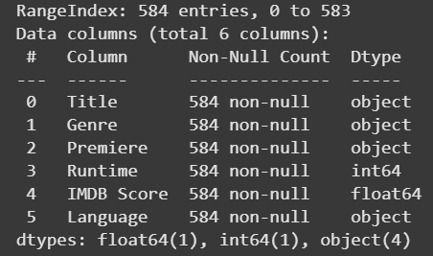
Data Profiling
Here we have observed that (Genre, language) are objects. To minimize the memory occupation and for higher performance, we convert the datatype to category which will help us to filter data easily.
And we convert the datatype of Premiere to datetime for better analysis in year wise , month wise and day wise fashion.
Since, There are no null values or duplicate rows in our dataset ,We do not have to drop or impute our features.

Slide 4
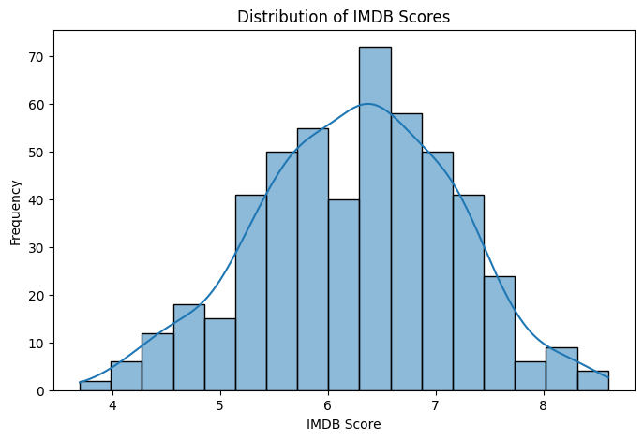
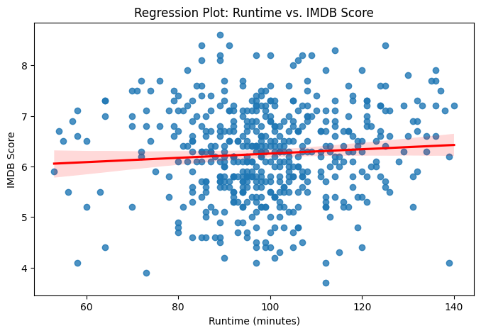
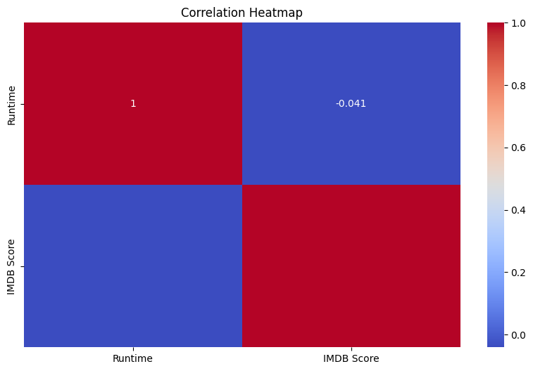
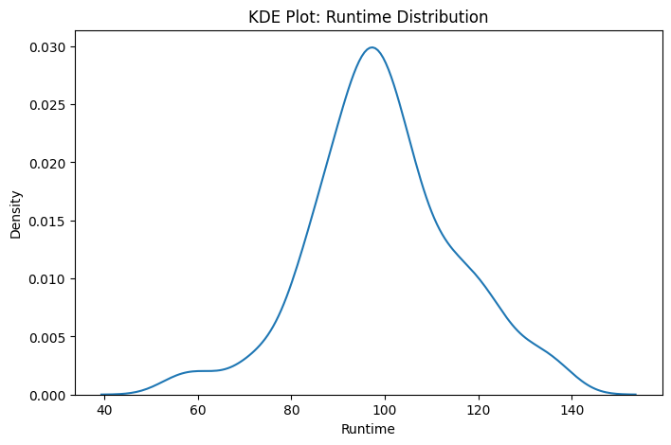
Visualization
Univariate(Histogram)
Bivariate(RegPlot)
Correlation(Heatmap)
Distribution(KDE)

Slide 5
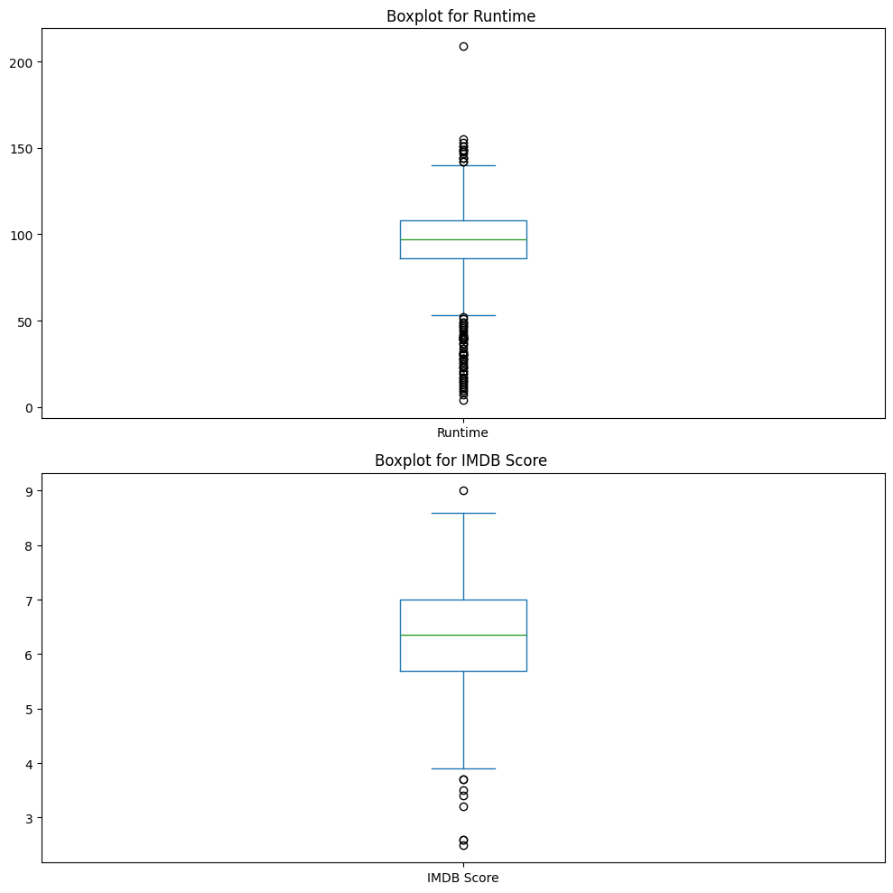
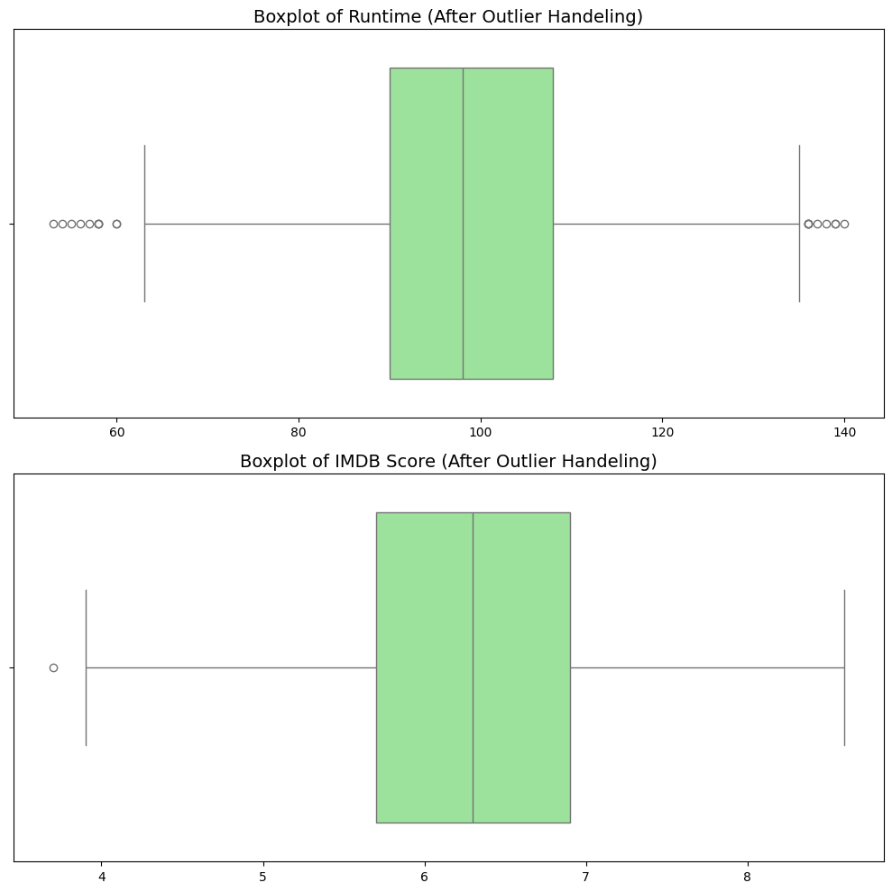
Outlier
Detection
Handling
Fig : Boxplot with outliers
Fig : Boxplot without outliers

Slide 6
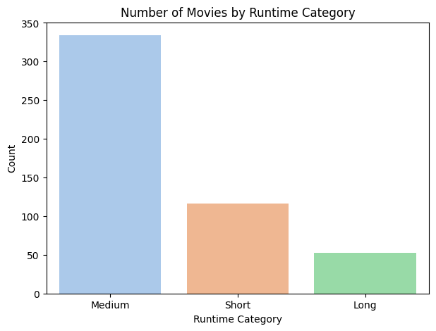
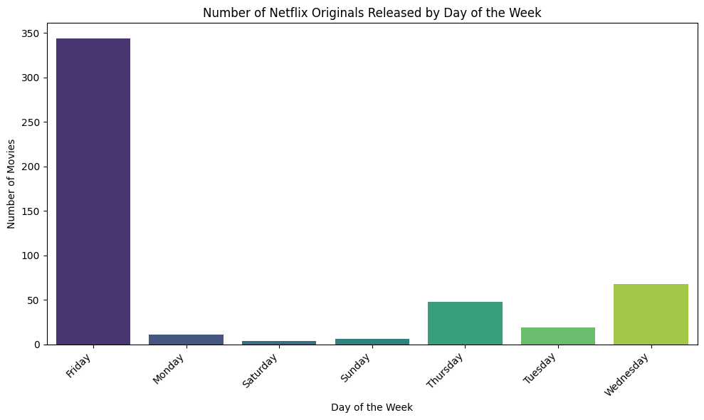
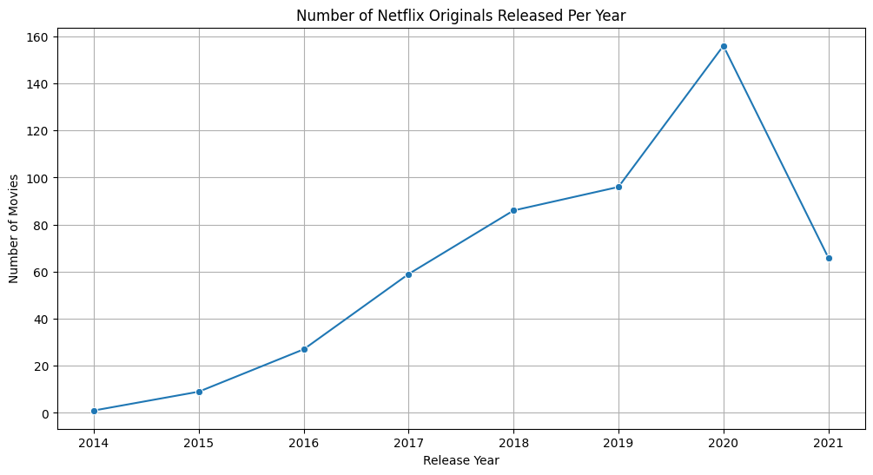
Feature Engineering
Initially our runtime column was in int, we categorized them into medium, short and long based on time-intervals. This helped us to understand our data better.
Initially our premiere column was object, we converted it into datetime. This helped us to analyze our data in yearly, monthly and weekday basis.
This way, it is easier to visualize our data and is also helps to predict future market and make rational decisions.

Slide 7
Key Findings
Most movies are medium length, which may not strongly impact ratings.
IMDB scores are slightly higher on average, mostly between 6 and 7.
English is the most common language.
Runtime and Rating outliers were present but handled.
Longer and older movies tend to have slightly better ratings.

Slide 8
Conclusion
In essence, the project follows a standard data science pipeline: understanding the data, cleaning it, exploring its characteristics, handling issues like outliers, enriching the data with new features, and then using these features to gain deeper insights and draw conclusions.

